Slide 1

Content last updated on 30th June 2026

Slide 2
Guidance
About the Greater Brighton Economic Board
GBEB is a partnership of local authorities, public bodies, universities and business organisations working together to support sustainable economic growth across the region. GBEB launched the Sussex Energy mission in 2024.
About Sussex Energy
It is a regional partnership bringing together local authorities, businesses, universities, community energy organizations and public sector partners to help Sussex achieve energy neutrality by 2040.
What is this pack?
This toolkit contains ready-to-use content to help organisations promote community energy initiatives taking place across Sussex to support the region's transition to a low-carbon future. You are welcome to select the content that is most relevant to your organisation’s audience and share it through your communication channels, including social media, newsletters, websites, etc. We’re launching this content in line with Community Energy Fortnight, but it can be used during the Fortnight and beyond to help raise awareness and showcase the positive impact of community energy projects across Sussex.
What is the Community Energy Fortnight?
It is an annual, nationwide campaign to showcase Community Energy. Community Energy Fortnight 2026 runs from 1–14 July.
Who is this pack for?
The communications content covers topics such as what is community energy, why and how to invest in community energy, advice and support provided by community energy organisations (e.g. energy advice, help with bills, business mentoring, etc.) and it shines a spotlight on some of the many, fantastic community energy groups we have in Sussex. This content is intended to be used by any organisation that thinks it could be of interest to their audience (e.g. local authorities, community energy organisations, energy companies, local businesses, citizens advice, universities, colleges, etc).

Slide 3
FAQs
Can I use the images?
Yes. All images and videos included in the communications content can be used by organisations communicating about energy. Each slide has picture guidance for your reference and alternative text/captions.
Can I adapt the content for my organisation?
Yes. The content in this toolkit is designed to be adapted for different audiences and channels. Organisations are encouraged to add their own branding, logos, local examples and calls to action while keeping the core message aligned with community energy awareness.
Do I have to use the content exactly as written?
No. This is a “pick and mix” resource. You can use content as provided or tailor it to suit your organisation, audience and communication channel.
Can I suggest content or corrections?
Yes. Feedback and corrections are welcomed to help keep the toolkit relevant and useful for partners across Sussex. Please contact us on GreaterBrighton@brighton-hove.gov.uk

Slide 4
Contents
What is community energy?
Why invest in community energy
Ouse Valley Energy Services Company CIC (OVESCO)
Brighton & Hove Energy Services Co-Op (BHESCo)
Brighton Energy Co-op (BEC)
Energise South
Community Energy Pathways
Energise South Downs
Energise Sussex Coast
Forest Row Co-op
Upcoming event: free energy advice session at the Heene
Greening Steyning

Slide 5



What is community energy?
Community energy organisations bring people together to collectively develop and own renewable energy projects. By keeping ownership local, they ensure that the social, environmental, and economic benefits, such as lower energy costs, reduced carbon emissions, and investment in the community, are shared by those who live there.
Their aim is to give communities greater control over how their energy is produced and used, while supporting a more sustainable future.
#CommunityEnergy #SussexEnergy
👉 Find more here: Shared Ownership - Community Energy Pathways
🎥Watch a video about it here: https://www.youtube.com/watch?v=3nKHraiKRXs&t=2s
OWNERSHIP
Community groups invest in renewable energy projects, keeping benefits local and giving
everyone the chance to participate.
Visual of solar panels and wind turbines powering a sustainable residential community
Images licensed for free use. No attribution or credit is required.
Lightbulb with words ‘Sussex has one of the UK’s strongest community energy networks. Every solar panel installed within Sussex keeps profits in our community.’
Illustration of a sustainable community.

Slide 6


Why invest in community energy?
Investing in community energy helps create a cleaner, fairer, and more resilient future for Sussex.
By investing, you can:
🌱 Support local renewable energy projects that provide clean energy for homes, businesses, and community organisations.
🏘️ Help keep profits within the local community, funding projects that deliver social, economic, and environmental benefits.
💷 Receive a potential financial return through community share offers while supporting positive climate action.
🌍 Accelerate the transition to net zero by backing affordable, locally owned renewable energy.
Find Community Energy Investment Opportunities
Community Energy England is the voice for the community energy sector. On the following page, community share offers from organisations across the UK are listed, giving people the opportunity to support renewable energy projects while helping create local environmental and community benefits. Investors can explore a range of projects and choose opportunities that align with their values and interests. 👉 Browse current share offers: Share Offers - Community Energy England. #CommunityEnergy #SussexEnergy
Together, we can build stronger, cleaner, and fairer Sussex
Illustration of local residents promoting investment in community energy
Tip: If posting on social media, tag Community Energy England.
Images licensed for free use. No attribution or credit is required.

Slide 7

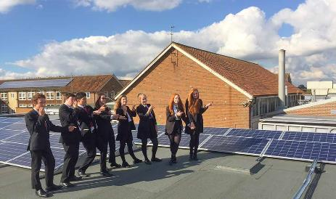
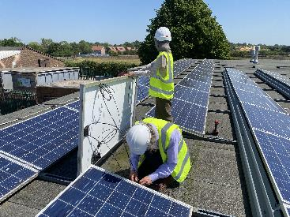
Ouse Valley Energy Services Company CIC (OVESCO)
OVESCO deliver community energy projects across East Sussex, including solar installations on schools, public buildings, Harvey’s Brewery and they even develop solar farms! They support individuals, businesses, and local groups to take practical climate action by generating clean, local energy, offering energy advice and developing community-led initiatives.
👉Visit their website for more info http://www.ovesco.co.uk
Local Project: OVESCO Sunny Solar Schools
Ouse Valley Energy Services Company CIC (OVESCO) has delivered community-funded solar projects on schools across Sussex, including sites in Lewes, Ringmer, Brighton and Eastbourne.
These installations:
🏫 Generate clean electricity for schools.
⚡Provide reduced-cost energy for up to 25 years.
🤝 Reinvest surplus income into local community benefits.
The project also helps educate pupils and communities about renewable energy and climate action. 👉check here for more info Sunny Solar Schools | Ovesco
https://www.instagram.com/reel/DZaTwEWN63F/?igsh=MTZmc3lqb3hnbGh1aQ==
#CommunityEnergy #SussexEnergy
OVESCO logo.
Students standing beside rooftop solar panels at a Sussex school supported by the OVESCO Sunny Solar Schools programme.
OVESCO team inspecting a solar panel at King’s Academy, Ringmer
Tip: If posting on social media, tag OVESCO.
Images licensed for free use. No attribution or credit is required.

Slide 8
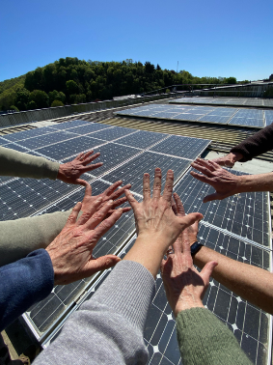
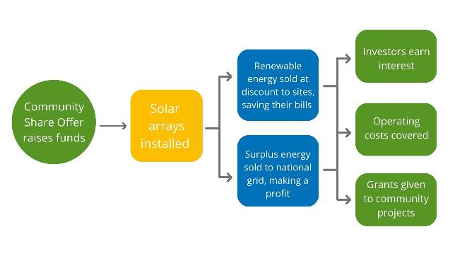
Invest in Community-Owned Solar with OVESCO
Ouse Valley Energy Services Company CIC (OVESCO) has helped communities across Sussex build nearly 6MW of community-owned solar generation, funded by local shareholders who invest in renewable energy projects.
As the diagram shows:
Community investment raises funds through local shareholders.
Solar arrays are installed on suitable sites across Sussex.
The electricity generated:
Is sold to host sites at a discounted rate, helping reduce energy bills.
Any surplus power is exported to the national grid, generating additional income.
4.The income from these projects helps:
  Pay interest to investors.
  Cover operating and maintenance costs.
  Fund grants for local community projects.
Hundreds of investors have already helped fund OVESCO's projects, creating clean energy and lasting community benefits.
👉Fill out this form if you want to be part of this amazing journey https://form.jotform.com/231084470724352. #CommunityEnergy #SussexEnergy
OVESCO team hands on Harvey’s Depot Solar Panels, Lewes.
Diagram showing how community investment funds solar installations, with income supporting investors, operating costs and community grants.
Images licensed for free use. No attribution or credit is required.
Tip: If posting on social media, tag OVESCO.

Slide 9


Free Thermal Imaging Camera Scheme
Ouse Valley Energy Services Company CIC (OVESCO) offers residents the opportunity to borrow a thermal imaging camera for free to identify where heat is being lost from their homes. The cameras create temperature-map images that can reveal hidden energy issues and help households improve energy efficiency and reduce energy bills and carbon emissions.
👉📸 Find out more and book a camera: Borrow a Thermal Image Camera | Ovesco
Free Energy Advice to Help Residents Save Money
OVESCO’s (Ouse Valley Energy Services Company CIC) Energy Champions provide free, impartial energy advice to help households manage energy costs, identify energy-saving opportunities, get expert advice on improving home energy efficiency and access available support. Advice is available through one-to-one appointments and drop-in sessions.
👉 Learn more about the service: Energy Advice | Ovesco
#CommunityEnergy #SussexEnergy
Thermal imaging camera available through OVESCO’s free loan scheme to help households identify heat loss and improve energy efficiency.
Promotional graphic for OVESCO’s free Eco Home Energy Advice drop-in service
Tip: If posting on social media, tag OVESCO.
Images licensed for free use. No attribution or credit is required.

Slide 10

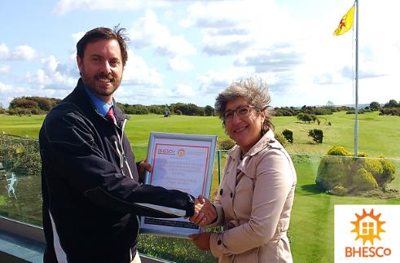
Brighton & Hove Energy Services Co-op (BHESCO)
BHESCo develops and finances community-owned clean energy projects, providing services like project management and consultancy to help homes, businesses, and councils reduce energy costs and carbon emissions without upfront costs. By doing that, low-carbon energy becomes more accessible, tackling fuel poverty and supporting communities in taking practical steps toward a fair transition to net zero.
👉 Visit their website for more info: https://www.bhesco.co.uk
Local Project: Solar PV at Dyke Golf Club
BHESCo (Brighton & Hove Energy Services Co-op) designed and funded an in-roof solar installation at Dyke Golf Club, installing a 37kW system with 90 solar panels on the clubhouse roof.
The project:
🌞 Generates clean, renewable energy on-site.
🍃 Reduces the club's energy costs and carbon emissions.
🔄 Was funded through community investment, keeping benefits local.
🎥 Learn more about it here: https://www.youtube.com/watch?v=Tt7pqE828pc
#CommunityEnergy #SussexEnergy
BHESCo logo.
Representatives marking the completion of BHESCo’s community-funded solar installation at Dyke Golf Club.
Image licensed for free use. No attribution or credit is required.
Tip: If posting on social media, tag BHESCo.

Slide 11
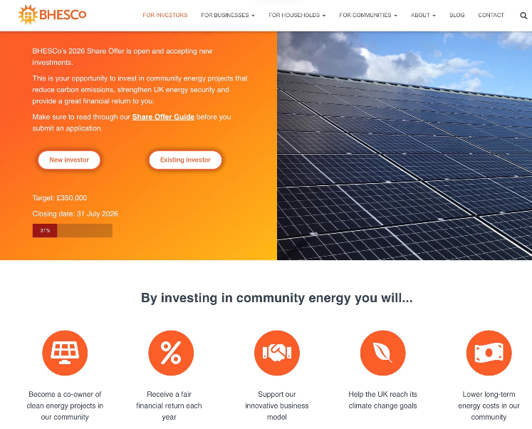
Invest in Community Energy with Brighton & Hove Energy Services Co-op (BHESCo)
BHESCo offers local people the chance to invest in renewable energy projects across Brighton & Hove, including solar panels, heat pumps, battery storage, and energy efficiency improvements.
By investing, you can:
🔆 Support clean, locally generated energy.
📈 Earn a potential return on your investment (target up to 5% interest).
🌟 Help fund projects that benefit your community.
🎥 Find out more about BHESCO 2026 share offer here (Closing 31st of July) https://www.youtube.com/watch?v=6P-o2nwmbQg
👉Click here to submit your share offer application BHESCo 2025 Share Offer Application - New Investor (Page 1 of 6)
#CommunityEnergy #SussexEnergy
BHESCo share offer webpage inviting local people to invest in community energy projects, including solar power, heat pumps and energy efficiency improvements
Image licensed for free use. No attribution or credit is required.
Tip: If posting on social media, tag BHESCo.

Slide 12
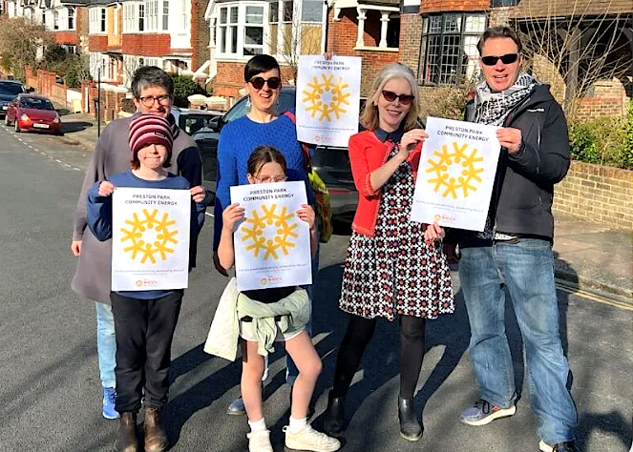
Local Project: Preston Park Community Energy Programme
Brighton & Hove Energy Services Co-op (BHESCo) worked with local residents and partners to launch Brighton’s first community-scale solar programme, helping households generate their own renewable electricity without upfront installation costs.
The project:
☀️ Installed rooftop solar panels across nine households in Preston Park.
⚡Provides residents with discounted solar electricity through a Power Purchase Agreement (PPA).
🔋 Delivers a combined 40kW of solar capacity and 50kWh of battery storage.
💰 Is expected to save participating households an average of £7,000 over the agreement term.
👉 Read more about the project: New solar panel scheme launched in Brighton's Preston Park — GRID
#CommunityEnergy #SussexEnergy
Residents participating in BHESCo’s Preston Park Community Energy Programme, which installed community-funded rooftop solar panels and battery storage across local households.
Image licensed for free use. No attribution or credit is required.
Tip: If posting on social media, tag BHESCo.

Slide 13

Local Project: Re-Energise Manor Royal
Brighton & Hove Energy Services Co-op (BHESCo) is working with Manor Royal BID to deliver the Re-Energise Manor Royal programme, a community-led initiative helping businesses across Manor Royal Business District reduce energy costs and carbon emissions through locally generated renewable energy.
The project:
🏢 Established an independent, non-profit Local Energy Community for Manor Royal businesses.
☀️ Supports the installation of rooftop solar PV systems across commercial buildings.
🔋 Aims to create a more sustainable, secure, and locally generated energy supply for the business district.
🚀 Offers opportunities for businesses to access solar installations at subsidised rates, with funding support available through the programme.
🎯 Contributes to Manor Royal’s ambition of becoming a low-carbon, low-cost energy community by 2030.
👉 Learn more about the project: Re-Energise Manor Royal - Our Projects - Manor Royal Business District - Crawley and Gatwick
#CommunityEnergy #SussexEnergy
Re-energise Manor Royal logo
Image licensed for free use. No attribution or credit is required.
Tip: If posting on social media, tag BHESCo and Manor Royal BID.

Slide 14
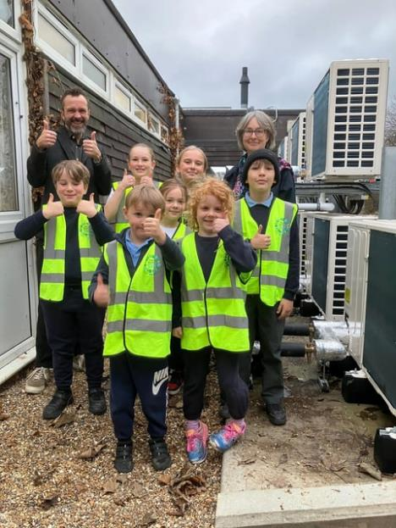
🏫 Local Project: Peter Gladwin Primary School Goes Fully Low Carbon
Peter Gladwin Primary School in Portslade has become the first school in Brighton & Hove to have all its heating and hot water powered by low-carbon technologies.
The project brought together Brighton & Hove City Council, community energy organisation BHESCo, local contractors and government funding to replace gas boilers with air source heat pumps and rooftop solar.
The project has:
☀️ Installed a 50kW rooftop solar array through BHESCo.
🔥 Replaced gas boilers with air source heat pumps, making it the city's first fully low-carbon heated school.
🌍 Reduced carbon emissions by an estimated 19 tonnes per year.
🤝 Demonstrated how local authorities, community energy organisations and local businesses can work together to deliver practical low-carbon projects.
👉 Find more about it here: Pupils celebrate first low carbon school heating system
Peter Gladwin primary school pupils celebrating the first low carbon school heating system

Slide 15

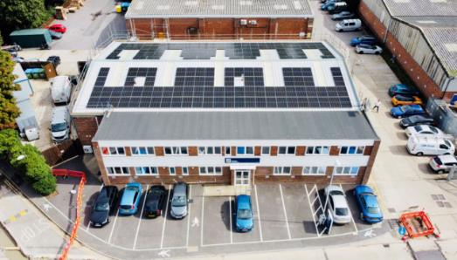
Brighton Energy Co-op (BEC)
BEC brings local people together to invest in community-owned solar energy projects across Sussex. Revenue generated from the solar electricity is shared between members and a community fund, helping to create a cleaner, fairer energy future.
👉 Visit their website for more info: Brighton Energy Cooperative | Community Energy Investment - Clean Energy for the People
Local Project: Community Solar Accelerator
Between 2021 and 2023, BEC delivered its Community Solar Accelerator programme, providing £714,400 in grants to 33 Sussex businesses to install solar panels and EV charging points. The project:
💡 Helped local businesses reduce energy bills.
🔆 Generated over 2.4 million kWh of solar electricity each year.
🌍 Cut around 848 tonnes of carbon emissions annually.
👉 Explore the case studies: CSA Grant Beneficiaries- Case Studies | Brighton Energy Cooperative
#CommunityEnergy #SussexEnergy
Industrial unit with solar panels
Images licensed for free use. No attribution or credit is required.
Tip: If posting on social media, tag BEC.

Slide 16
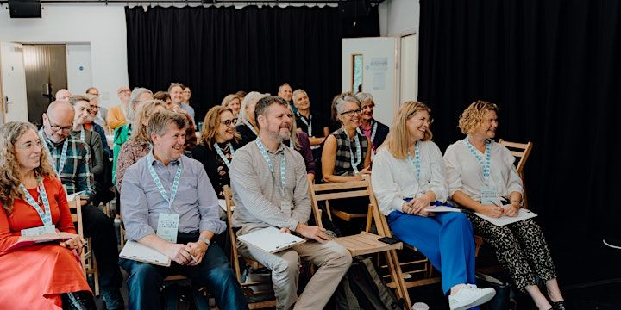
Get Involved: Free Mentoring for Impact-Led Organisations
Brighton Energy Co-op (BEC) is currently offering free mentoring for local not-for-profits, sustainable businesses, and purpose-driven organisations. The programme provides strategic guidance and access to the experience of BEC's staff and directors.
👉 Find out more: Mentoring | Brighton Energy Cooperative
There are not live investment opportunities at present, but subscribe here to stay updated on future offers
👉 https://www.brightonenergy.org.uk/product/invest/
#CommunityEnergy #SussexEnergy
Attendees at a BEC event.
Images licensed for free use. No attribution or credit is required.
Tip: If posting on social media, tag BEC.

Slide 17
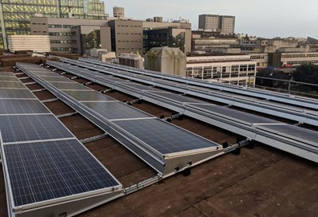
Local Project: Community-Funded Solar at the University of Brighton.
The University of Brighton and Brighton Energy Co-op (BEC) have partnered to install community-funded solar panels on the university’s city campus, demonstrating how organisations can work together to increase local renewable energy generation.
The project has:
☀️Installed 222 solar panels with a generating capacity of almost 60kW.
⚡Generated more than 50,000 kWh of renewable electricity each year.
🌍Reduced carbon emissions by over 20 tonnes of CO₂ annually.
🤝 Used a community-funded model, with Brighton Energy Co-op financing and operating the installation.
💷 Helped reduce energy costs while increasing the university's use of locally generated renewable power.
👉 Find more about it here: University's new solar system
Installation of 222 solar panels on University of Brighton city campus.

Slide 18

Community energy: a unique opportunity to do things differently
Energise South is a community benefit society created to develop community-funded solar energy to benefit the people of East Sussex. Since launching in 2019 it’s installed solar PV systems on 11 sites across East Sussex, including schools, community buildings and local businesses.
These projects are estimated to have saved these projects £62,000 a year in saved energy costs last year. For example, during 2025, St Leonards Academy paid only 11p per kWh for the energy generated from its community-owned panels – less than half of the average business electricity price of 24p per kWh.
Energise South director Kate Meakin said: 'As a country – and as a world – we’re currently in a transition to net-zero greenhouse emissions. And this means – because renewable energy is much more decentralised than fossil fuels or nuclear – that we’ve got this unique opportunity now to do things differently. We can either choose to recreate what we have now: massive energy companies owning everything and individuals just having to pay their energy bills to these companies and that money just leaving our communities. Or we can use this opportunity to try and create something that is better for communities, with local power-generation assets owned and controlled by local people.'
👉 Find out more here. #CommunityEnergy #SussexEnergy
Energise South logo
Tip: If posting on social media, tag Energise South.
Images licensed for free use. No attribution or credit is required.

Slide 19
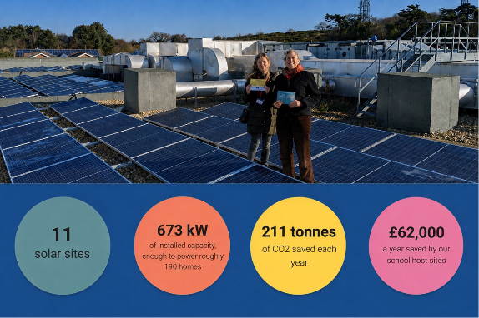
Invest in Community Energy with Energise South: the Bridge Leisure Centre Solar Project
As part of its upcoming community share offer, Energise South is installing 336 community-owned solar panels on the roof of The Bridge Leisure Centre in Horsham. The project will help the leisure centre reduce energy costs while enabling local people to invest directly in the area's clean energy transition.
The project will:
☀️ Generate over 140,000 kWh of clean solar electricity each year.
🔌 Supply approximately 30% of The Bridge Leisure Centre's annual electricity demand.
🍃 Reduce carbon emissions by around 50 tonnes annually.
💰 Save the leisure centre an estimated £12,000 in energy costs in the first year.
👉 Explore the case study: ‘A great opportunity’: Community Energy Horsham & The Bridge leisure centre – Energise Sussex Coast
At the moment, Energise South’s Community Share Offer is not out yet but you can register your interest 👉 here to receive the document as soon as it becomes available. You can also learn more about Energise South and community share offers in the interview with Kate Meakin and Mike Smythe 👉 here. #CommunityEnergy #SussexEnergy
Energise South director Kate Meakin and Julia Hilton beside the community-owned solar installation at Hastings Academy, with project figures showing 11 solar sites generating 673kW of renewable energy capacity.
Images licensed for free use. No attribution or credit is required.
Tip: If posting on social media, tag Energise South.

Slide 20

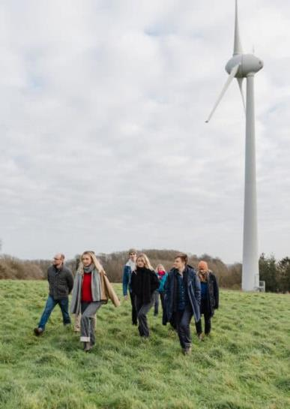
Community Energy Pathways
Community Energy Pathways supports community energy groups to develop low-carbon projects by providing training, expert advice, and project management. Through a shared learning network and practical guidance, the organisation helps improve energy efficiency, reduce emissions, and ensure affordable energy access, particularly for vulnerable households.
👉 Find out more here: https://www.communityenergypathways.org.uk
Local Project: Community Energy People
The Community Energy People project is helping community energy groups across England grow their impact by creating jobs, supporting volunteers, and building local capacity for renewable energy projects.
The project has:
🧑‍💼 Created 51 part-time jobs across community energy organisations.
💜Provided 88 volunteering opportunities.
☀️ Supported the development of 0.282 MW of community-owned rooftop solar.
🪙 Helped raise over £302,000 through community share offers.
📣 Reached nearly 7,000 people through energy advice and engagement activities.
👉 Explore the project here: Community Energy People - Community Energy Pathways #CommunityEnergy #SussexEnergy
Community Energy Pathways logo
Participants in the Community Energy People project visiting a community wind turbine.
Images licensed for free use. No attribution or credit is required.
Tip: If posting on social media, tag Community Energy Pathways.

Slide 21

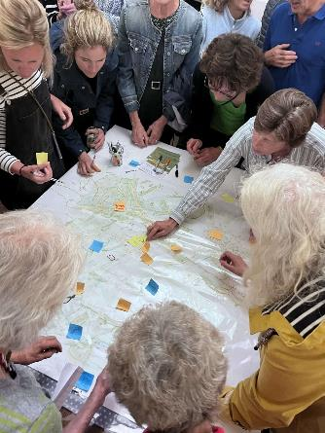
Energise South Downs
Energise South Downs run Future Energy Landscape workshops to engage communities to inform them to make educated decisions about energy. They also develop locally owned renewable energy projects funded by community investment. The organisation helps reduce carbon emissions, lower energy costs, and reinvest profits into local initiatives such as energy advice and fuel poverty support, giving communities greater control over their energy use.
👉 Find out more here: https://esd.energy/
Local Initiative: Future Energy Landscapes Workshops
Energise South Downs is running Future Energy Landscapes workshops to help local communities learn about renewable energy and how it can meet future energy needs. These interactive sessions help people explore ideas and shape a greener future for their area.
👉 Learn more about this initiative and book a free place for their upcoming workshops: Future Energy Landscapes - Energise South Downs
#CommunityEnergy #SussexEnergy
Energise South Downs logo
Residents taking part in an Energise South Downs Future Energy Landscapes workshop.
Tip: If posting on social media, tag Energise South Downs.
Images licensed for free use. No attribution or credit is required.

Slide 22
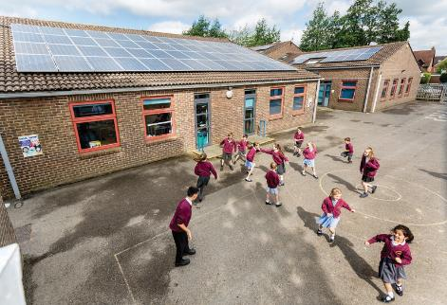
Community Energy investments with Energise South Downs
In 2025, Energise South Downs (ESD) gave people the opportunity to invest in community-owned renewable energy projects across Hampshire through its first community share offer. The offer raised £302,000 in just 10 days, funding three rooftop solar installations with a combined capacity of 283 kWp.
By investing, members were able to:
⚡Support clean, locally generated renewable energy.
📈 Earn a target return of up to 5.5% per year.
🌍 Help fund local climate action and community benefit initiatives.
🤝Become members of ESD and have a say in how community funds are invested locally.
The solar projects are expected to generate around 270,000 kWh of clean electricity annually and save approximately 54 tonnes of carbon emissions each year, while helping local organisations reduce their energy costs.
👉 Sign up for future investment opportunities: Newsletter Archive - Energise South Downs.
If you want to become a member of Energise South Downs and have a say in how the organisation is run and how it spends the community benefit fund please click 👉 here. You can become a member for just £1, and this will entitle you to one vote in the annual AGM and you will be added to the member’s register.
#CommunityEnergy #SussexEnergy
School pupils playing in a playground beside a rooftop solar installation funded through Energise South Downs’ community share offer.
Images licensed for free use. No attribution or credit is required.
Tip: If posting on social media, tag Energise South Downs.

Slide 23


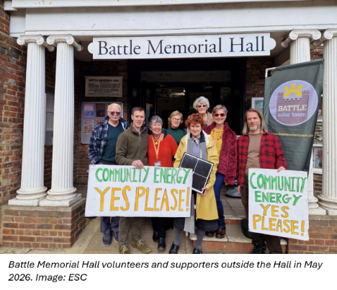
Energise Sussex Coast
Energise Sussex Coast works with local people to tackle climate change and high energy costs by developing community-owned renewable energy and energy-saving projects.
👉 Find out more here: http://energisesussexcoast.co.uk
Local Project: Battle Solar Town
Battle Solar Town is a community-led initiative working with Energise Sussex Coast to make Battle the UK's first "solar town" by generating at least 25% of the town's electricity demand from rooftop solar panels. The project aims to:
🏠 Increase the use of solar panels on homes, community buildings, schools, and local businesses.
🌞 Generate more locally produced renewable energy and reduce reliance on fossil fuels.
🗺️ Help residents understand the solar potential of their properties through a detailed solar map of the town.
💚 Ensure profits from locally generated energy are reinvested into community projects through a community benefit fund.
👉 Find out more: Ambitious plan to generate 25% of Battle’s energy on rooftops to become UK’s first ‘solar town’ and here Battle Solar Town.
#CommunityEnergy #SussexEnergy #BattleSolarTown
Energise Sussex Coast logo
Battle solar town logo
Tip: If posting on social media, tag Energise Sussex Coast.
Images licensed for free use. No attribution or credit is required.

Slide 24

Energise Sussex Coast celebrates community energy fortnight
Energise Sussex Coast will be marking this year's Community Energy Fortnight (1 – 14 July 2026) with the following event in Hastings:
> Community energy, yes! Photo-call & celebration. 6.30pm, Thursday 9 July, by Goat Ledge Cafe, Hastings (TN37 6FA).
Join ESC to celebrate 14 years of local community energy projects + be part of the photo-call for our upcoming community share launch. Free badges for all participants. Cake!
ESC will also be holding two free online community webinars:
> SOLAR & BATTERIES, Tuesday 7 July, 6.30pm. More info + register here.
> HEAT PUMPS, Tuesday 14 July, 6.30pm. More info + register here.
Come and find out everything you need to know to start generating your own electricity and break free of expensive oil & gas heating!
And ESC will also be holding free energy advice and refrofit drop-ins in Ashburnham, Bexhill, Eastbourne, Etchingham and Hastings. See here for full info.
#CommunityEnergy #SussexEnergy
Graphic: solar character
Tip: If posting on social media, tag Energise Sussex Coast.

Slide 25

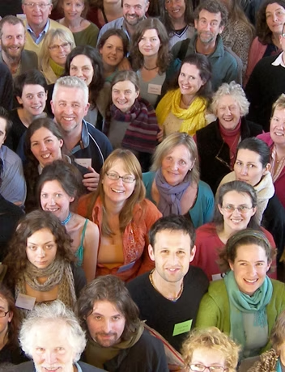
Forest Row Energy Co-op
Forest Row Energy Co-op is a non-profit, community-owned organisation that helps local people take greater control of their energy use through renewable energy and energy efficiency projects. The co-op aims to build a more self-sufficient community, reduce environmental impact, and promote affordable, locally generated energy.
👉 Find out more here: Home | Forest Row Energy
Alongside this, the co-op provides practical support such as:
Trusted supplier recommendations
👉https://www.forestrowenergy.com/local-suppliers
Independent bill and quote reviews
👉 https://www.forestrowenergy.com/quotes-bills-review
Guidance on grants and funding opportunities
👉 https://www.forestrowenergy.com/grants
#CommunityEnergy #SussexEnergy
Forest Row Energy logo
Members of the Forest Row Energy Co-op
Images licensed for free use. No attribution or credit is required.
Tip: If posting on social media, tag Forest Row Energy Co-op.

Slide 26

Local Initiative: Community Drop-in at Forest Row Community Centre
Forest Row Energy Co-op runs a monthly drop-in session at Forest Row Community Centre, held alongside the Repair Cafe to reach residents who share a practical, resourceful approach to sustainability.
The sessions offer:
🆓Free, face-to-face energy bill and quote reviews.
❓Answers to questions about heat pumps, solar, grants and energy efficiency.
🤝A trusted, impartial voice in a familiar community setting.
By co-locating with the Repair Cafe, the co-op connects with residents who may not seek out energy advice online - including older residents, those on fixed incomes, and households in fuel poverty.
Forest Row Energy Co-op also publishes a free weekly newsletter covering local energy news, tips, funding opportunities and project updates.
📬Subscribe at: Forest Row Energy
Forest Row Repair Café logo

Slide 27
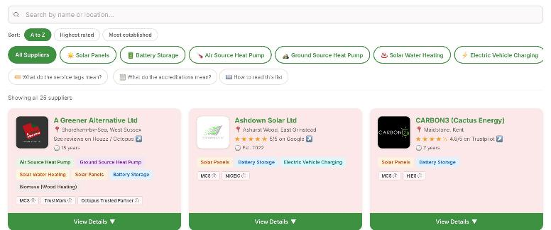
Local Resource: Audited Suppliers List
Forest Row Energy created an Audited Suppliers List to help residents find trusted local renewable energy installers with confidence.
The resource:
🔎 Provides a directory of vetted local suppliers for solar panels, heat pumps, battery storage, and more.
✅ Reviews installers’ certifications, accreditations, and public customer feedback.
💬 Explains technical information in plain English.
🧭 Helps residents make informed decisions without feeling overwhelmed.
👉 Find a vetted supplier:
https://www.forestrowenergy.com/local-suppliers
#CommunityEnergy #SussexEnergy
Forest Row Energy’s Audited Suppliers List webpage.
Images licensed for free use. No attribution or credit is required.
Tip: If posting on social media, tag Forest Row Energy Co-op.

Slide 28
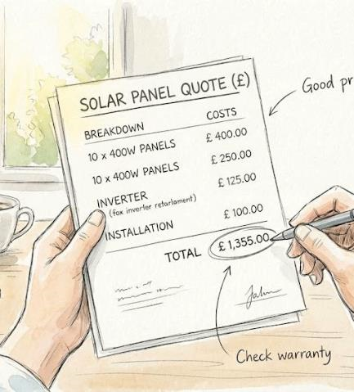
Local Resource: Bill & Quote Review Service
Forest Row Energy offers an independent Bill & Quote Review Service to help residents understand energy costs and installation proposals before committing.
The service:
🛡️ Provides independent, impartial feedback.
💷 Helps residents check whether they are receiving a fair deal.
🎓Supports more informed decisions on energy improvements and renewable technologies.
This service helps build confidence and trust, ensuring residents can navigate energy choices with expert support.
👉 Learn more: https://www.forestrowenergy.com/quotes-bills-review
#CommunityEnergy #SussexEnergy
Illustration of a solar panel installation quote
Images licensed for free use. No attribution or credit is required.
Tip: If posting on social media, tag Forest Row Energy Co-op.

Slide 29
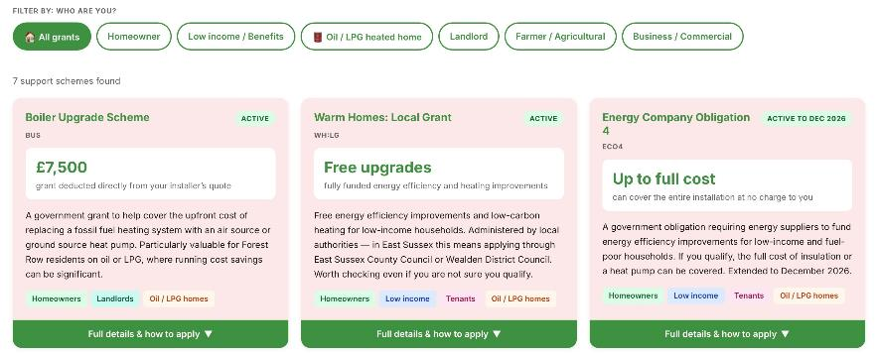
Local Resource: Grant Finder
Forest Row Energy developed a Grant Finder tool to help residents identify funding opportunities for home energy improvements.
The tool:
🎯 Matches residents with grants and support schemes they may be eligible for.
🔥 Highlights opportunities such as the Boiler Upgrade Scheme.
💸 Simplifies the process of finding financial support.
👉 Explore the Grant Finder: https://www.forestrowenergy.com/grants
#CommunityEnergy #SussexEnergy
Forest Row Energy’s Grant Finder webpage
Images licensed for free use. No attribution or credit is required.
Tip: If posting on social media, tag Forest Row Energy Co-op.

Slide 30
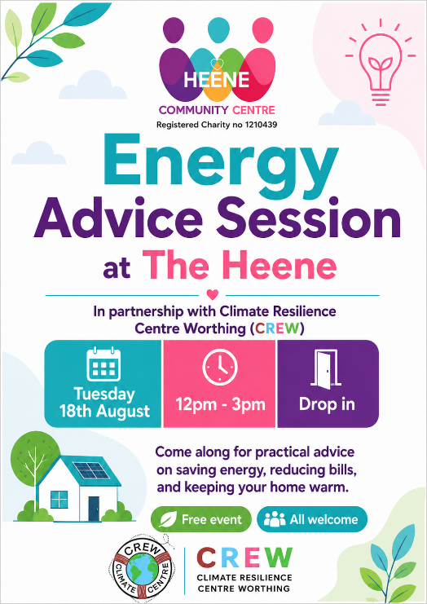
Upcoming Event: Free Energy Advice Session at The Heene
The Climate Resilience Centre Worthing, in partnership with The Heene Community Centre, is hosting a free drop-in Energy Advice Session to help residents reduce energy costs and keep their homes warm.
This event highlights how local organisations are working together to provide trusted, accessible energy advice and help residents take positive steps towards a more sustainable future.
📅 Date: Tuesday 18th August
🕛 Time: 12pm – 3pm
📍 Location: The Heene Community Centre, Worthing
🚪 Format: Free drop-in session
👉 Learn more: Climate Resilience Centre Worthing | Climate Emergency Centre in Worthing.
#CommunityEnergy #SussexEnergy
Poster promoting a free Energy Advice Session at The Heene Community Centre in Worthing
Tip: If posting on social media, tag The Heene and Climate Resilience Centre Worthing (CREW).

Slide 31

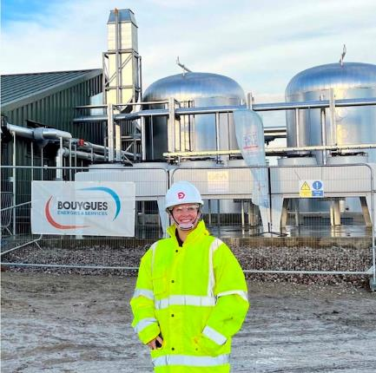
Greening Steyning
Greening Steyning is a local group working to create a sustainable, low-carbon future for Steyning, Bramber, Upper Beeding and the surrounding area. Their aim is to get the whole community thinking about what they can do to tackle climate change and take action to make a difference.
Local Initiative: Retrofit Knowledge Sharing Workshop
Greening Steyning brought together climate action groups from across Sussex and Hampshire to share experiences and explore ways to help more people improve the energy efficiency of their homes.
The workshop:
🤝 Encouraged collaboration between community groups working on home retrofit and energy efficiency.
🗣️ Shared practical approaches for engaging residents and building trust around retrofit projects.
🚧 Explored barriers such as costs, access to information, and finding reliable advice and installers.
🌟 Highlighted the importance of partnerships, local knowledge, and community-led support in helping households reduce energy use and carbon emissions.
👉 Read the full report here: retrofit knowledge sharing workshop
#CommunityEnergy #SussexEnergy
Greening Steyning logo
Person in high visibility jacket and helmet on industrial energy site
Images licensed for free use. No attribution or credit is required.
Tip: If posting on social media, tag Greening Steyning.

Slide 32

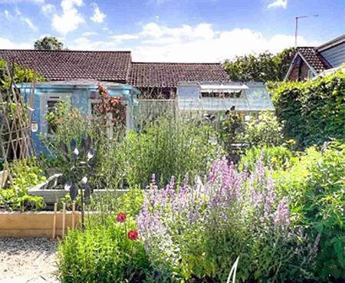
Local Event: Eco Open House 2026
Greening Steyning organized the Eco Open House 2026, giving residents the opportunity to visit homes and buildings across Worthing, Shoreham and Steyning that have been made more sustainable. Visitors could see a range of improvements in action, including heat pumps, rooftop solar panels with battery storage, and wildlife-friendly gardens that support pollinators and biodiversity.
People who joined this event were able to meet local homeowners, see energy-saving improvements up close, and hear honest experiences about what worked, what it cost, and the benefits they've seen. These open houses offered practical inspiration and the opportunity to ask questions in a real-life setting.
👉 Find out more about it: Eco Open House
🎥 See a video of one of the visited homes https://youtu.be/vgO0MvZrEKg?si=1gJOFCoV3 mmM6GM
If you are not in these areas but keen on eco open houses, other organisations such as OVESCO holds similar events. OVESCO offers it across Barcombe, Lewes, Rodmell, Hassocks, Ditching, Newhaven and Seaford.
👉 Find more about it here: Successful Eco Open Home in the Lewes District | Ovesco
#CommunityEnergy #SussexEnergy
Eco Open Houses logo
House and wildlife-friendly garden featured in Greening Steyning’s Eco Open House 2026
Images licensed for free use. No attribution or credit is required.
Tip: If posting on social media, tag Greening Steyning.

